Slide 1
Active SLAM in Structured Environments
Cindy Leung, Shoudong Huang and Gamini Dissanayake
Presented by: Arvind Pereira for the CS-599 – Sequential Decision Making in Robotics

Slide 2
Active SLAM Problem Definition
Plan a trajectory for the robot such that :
Line features in the environment can be estimated accurately and efficiently
Requires an estimation algorithm for line features and robot poses using the observations and process information

Slide 3
Line Representation
Active SLAM in this work is performed using “line features” as opposed to “point features”
Equation of line used:
For each line feature, several line segments may be found, and stored as:
Array stored but not included in SLAM state vector

Slide 4
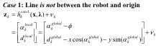
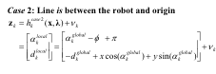
Observation Model
General Observation Model is:

Slide 5
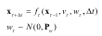
Process Model
velocity
Turn-rate
Stabilizing noise added to cov. of robot pose for Unmodelled Process noise

Slide 6
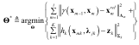
Incremental SLAM
Relative Position between observations
SLAM as a Least-squares problem

Slide 7
Incremental SLAM contd…
The first part is the Process Innovation:
Odometry Prediction error
Jacobians of Relative position equation
Initial guess of the robot poses

Slide 8
iSAM contd…
The second part is the Observation Innovation
Measurement prediction error
Jacobians of Observation Equation
Intial guess of the feature observed

Slide 9
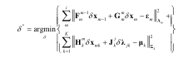
Solve a Linearized Least Squares Problem:
Noise covariances can be expressed as :
A contains the jacobians, b contains the innovations. Repeatedly solve the linearized least squares process until the solution has converged until is < Threshold

Slide 10
Data-Association
Performed by extracting EKF state and covariance from iSAM state vector and A
To get the covariance P
Find the information matrix
Compute Covariance
The EKF state and its covariance are extracted using the current robot pose and all features. Using these values, standard nearest neighbor method is applied for data-association

Slide 11
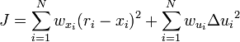
Trajectory Planning (1)- MPC
Primary objective is to minimize the uncertainty of the estimate
Cannot use Optimal control with fixed models due to uncertainties!
Model Predictive Control (MPC) with an attractor is used as the optimization strategy
Multi-step control optimization for MPC uses EKF algorithm while current estimate for MPC comes from iSAM

Slide 12
Trajectory Planning (1) contd…
Obstacle avoidance is performed by using the current laser scan and doesn’t rely upon the SLAM output (since not all obstacles are necessarily lines!)
Makes sense because the range of the sensor is much larger than the planning horizon of the robot

Slide 13
Line segment prediction
The control is based upon Information gain, and hence needs a means of predicting line segments which might be observed
Can be done using the predicted robot pose and the line segments
If robot is predicted to observe an adequate number of sensor measurements to an estimated line feature, that line is observed!
Covariance of the predicted line observation is predicted by simulating noises in range measurements associated with the line feature

Slide 14
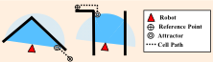
Trajectory Planning (2) - Attractor
Attractor is a virtual point feature
Attractor leads the robot toward a reference point where the robot should be heading to
It is placed at the first cell on the occupancy grid which is visible to the robot

Slide 15
Reference Point for Exploration
An occupancy grid is also used to determine frontiers for exploration and traversable areas
A reference point for localization is one used in the explore state when frontier points are extracted from the occupancy grid
The frontier region is selected based upon minimum absolute bearing to the robot – used to minimize turning

Slide 16
Reference Point for Localization and Mapping
Reference point for localization is usually a well defined feature
Mapping reference points are those with poorly defined features
Determined by thresholding covariances of features of interest
Once a group of potential reference points are obtained, the distance transform is computed for the occupancy grid map and the reference point is selected based upon minimum traversable distance

Slide 17
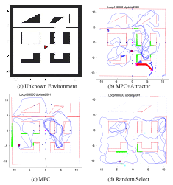
Simulation Results

Slide 18
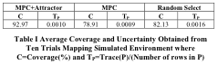
Comparison of MPC+A, MPC and RS

Slide 19
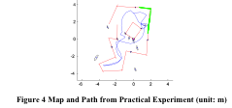

Experimental Results

Slide 20
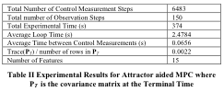
Loop and Timing characteristics

